Slide 1
Keep the lights on
Prepared by:
CPSC 471 – Group 2

Slide 2

Description of the problem.
Create a database management system that:
Tracks inventory and products along the value chain
Is able to support the company’s sales and manufacturing of diverse LED products
Supports an efficient quote system that handles and tracks orders within the company
Maintains privileged access for certain employees who have overview of critical features

Slide 3

Why is it important to solve this problem?
The R&D, Engineering and Sales department involves integration of complex tasks and requires employees from various departments to coordinate their project inventory needs efficiently with Vendors.
Simultaneously, customer needs must be met in a timely manner or the company risks losing business.
Vendors must be provided with orders so that the inventory is optimized.

Slide 4


Who will be the potential owner of the software?
Nemalux INDUSTRIAL - the industrial and hazardous location outdoor LED lighting solutions company

Slide 5

Who are the expected customers?
Nemalux INDUSTRIAL – primary customer
The solution can potentially afterwards be offered, customized and implemented in other similar industry companies that manufacture made-to-order parts.

Slide 6



How much are the customers expected to know in order to use the software?
The focus will be on the user-friendly, easy navigating solution, that will facilitate Client’s needs in a timely and efficient manner
Initial User Training
Supporting User Manuals

Slide 7
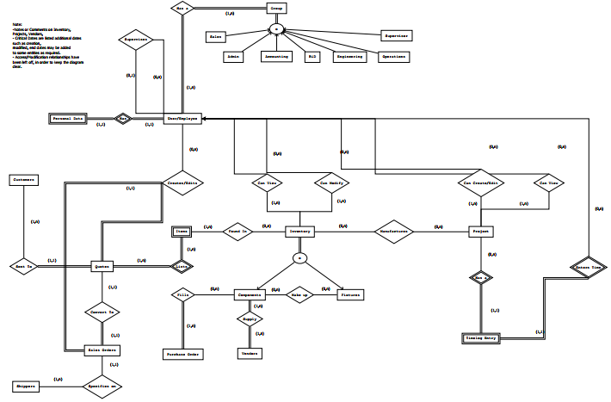
The ER model?

Slide 8
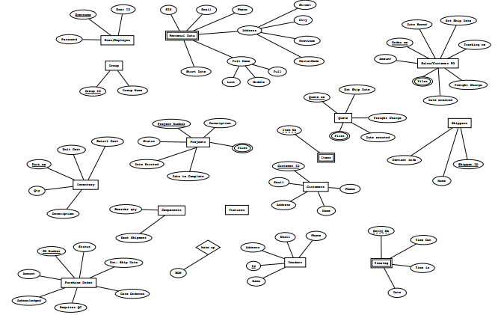
The ER model?

Slide 9
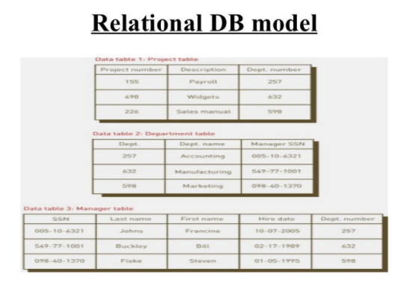

Your plan of what to do next.
Relational Model
Functional (programming) part

Slide 10
Questions?

Slide 11
Thank you!

